Slide 1
E-Commerce Data Manipulation using RPA
Team Members :
1. Sridhar R [711715104058]
2. Swathika G [711715104065]
3.Yeesha Sharookhan S [711715104308]
Faculty guide : Industrial guide :
Mrs. Lanitha B Mr. Jaydeep
AP CSE
Department of CSE, KGiSL Institute of Technology, Coimbatore

Slide 2
Abstract
E-commerce data manipulation using RPA is an automation project that will produce the various book details to clients via e-mail. When we search for a particular book using ISBN number in any e-commerce website, the result is not ready for consumption and is not clearly formatted. ISBN refers to International Standard Book Number.
This project reduces the time and effort required to drill down the relevant book information and collates the automated results in an excel which is easy to consume, visualize and understand by the clients.
Department of CSE, KGiSL Institute of Technology, Coimbatore

Slide 3
RPA
Robotic process automation (or RPA) is an emerging form of business process automation technology based on the notion of software robots.
Benefits:
1) Reduced costs
2) Time save
3) Better customer experience
4) Lower operational risk

Slide 4
Area Introduction-Existing system
1) Normal search suggests Venn Diagram Generator
This generates a Venn diagram based on the information that is from multiple web sites . The integrated results at the centre of Venn diagram is provided to the users in the specified visualized format. If there are any fraudulent websites, the resultant integrated data will not be accurate.
Department of CSE, KGiSL Institute of Technology, Coimbatore

Slide 5
Proposed System
Advantages over existing methods
The results of E-Commerce search using RPA are in well documented format.
Time consumption is reduced.
The automated results will be produced in excel format which is easy to visualize and understand.
Minimal man power consumption.
Computational errors and mistakes are minimized.
Department of CSE, KGiSL Institute of Technology, Coimbatore

Slide 6
Proposed System
Future Enhancements
The initial data which is not in documented form can be converted to Business file and can be exported via mail to required customer.
The resultant excel sheet can be uploaded to moodle or any other educational website which is useful for the reference of students.

Slide 7
Tools used
UiPath:
UiPath is a software structure to improve automation applications. It runs on Microsoft Windows and it was settled on the top of Net framework and Windows workflow base tools. UiPath scores best in technology category.
There are three main components in UiPath. UiPath Studio is a tool that enables you to design automation processes in a visual manner, through diagrams. UiPath Robot executes the processes built in Studio, as a human would. UiPath Orchestrator is a web application that enables you to deploy, schedule, monitor and manage Robots and processes.
Department of CSE, KGiSL Institute of Technology, Coimbatore

Slide 8
Literature review
Drawbacks of existing methods
Time consumption for data extraction
Network traffic
Incorrect ISBN numbers may lead to errors
References
Google Suggest Venn Diagram Generator
https://www.searchenginejournal.com/viral-projects-based-on-google-suggest/26457/

Slide 9
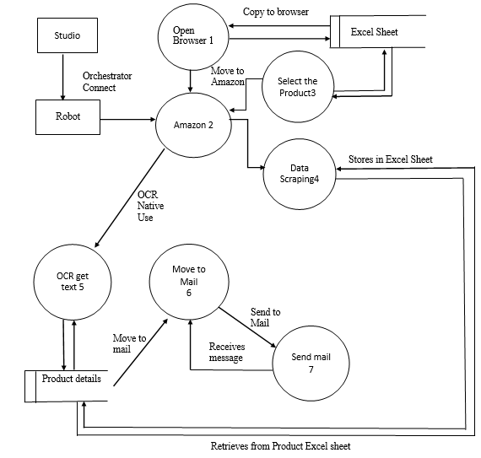
Architectural Design (DFD Level -> 1)
Department of CSE, KGiSL Institute of Technology, Coimbatore

Slide 10
Module Split up
Module 1: Input Business File
Module 2: Search the required ISBN Number
Module 3: Web Manipulation and extraction
Module 4: Business File Report Generation
Module 5: File transfer via E-mail
Department of CSE, KGiSL Institute of Technology, Coimbatore

Slide 11
Input Business File
The client will send the details about the ISBN numbers of various books which are to be processed.
The input business file can be obtained in any of the below two formats:
Excel
PDF

Slide 12
Input Business File
Based on the subject and date, the email will be checked and the attachment will be downloaded automatically.(Only the unread mail will be checked and it will be processed).
In case, if the client sends the attachment as an PDF then it will converted into word document and then the further steps will be processed.
In case, if the client sends the attachment as excel then it will be processed directly.

Slide 13
Search the required ISBN number
The Search books using ISBN module is used for surfing the specified books based on the ISBN number in the e-commerce website. It prompts the user to order the type of books via online based on some basic information about the products provided by the bot. We have made a provision for searching the ISBN code number list via online. All the manipulation data are been recorded by the bot for future purposes.

Slide 14
Web manipulation and Extraction
This module is used for manipulation of some basic information about the product specified by the customers. It allows users to have a gist look about the product specified in all E-commerce websites and compare the similar items to the product specified. It provides some basic details about the books such as the book publications, cost of the book, year of editions, and the availability of the specified book in that e-commerce website. Then the manipulated details are extracted to generate a business file.

Slide 15
Business file report generation
From the above web manipulation and extraction module, the required details about the books are manipulated and extracted.
These details are then consolidated and collated to form an excel sheet which is a business file.

Slide 16
Hardware and Software Requirements
Software specifications
UiPath studio
.Net framework
Hardware specifications
4GB ram
I3 processor
Communication Interface
Windows
Department of CSE, KGiSL Institute of Technology, Coimbatore

Slide 17
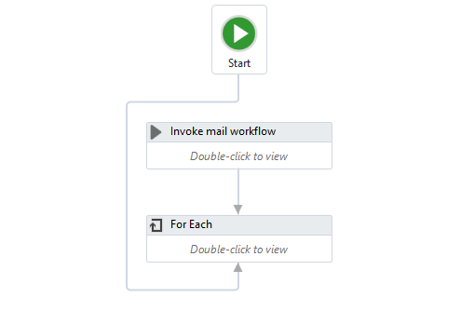
Automated Till…

Slide 18
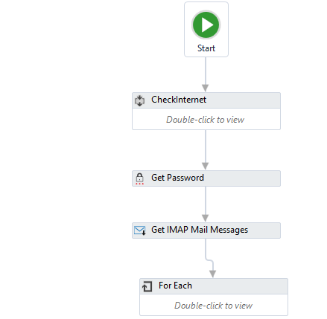
Mail flow

Slide 19
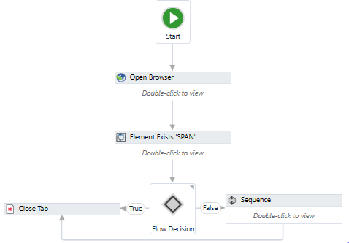
Account signout flow

Slide 20
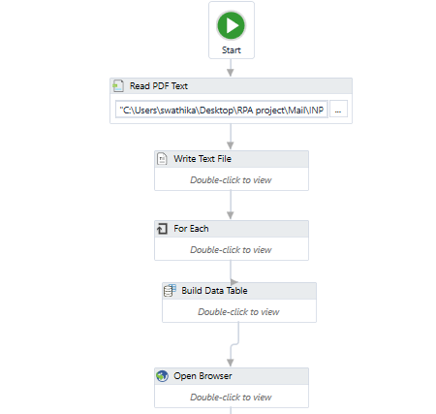
Pdf data flow

Slide 21
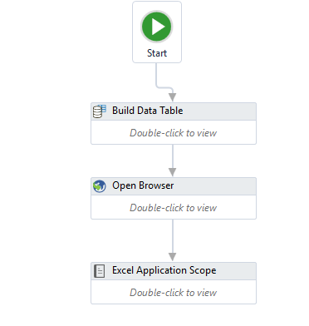
Excel data flow

Slide 22
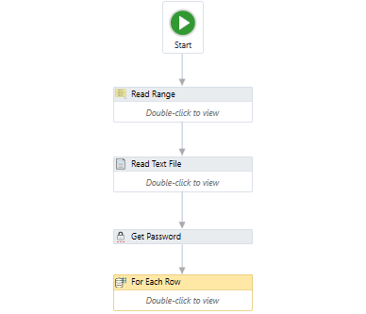
Send mail flow

Slide 23
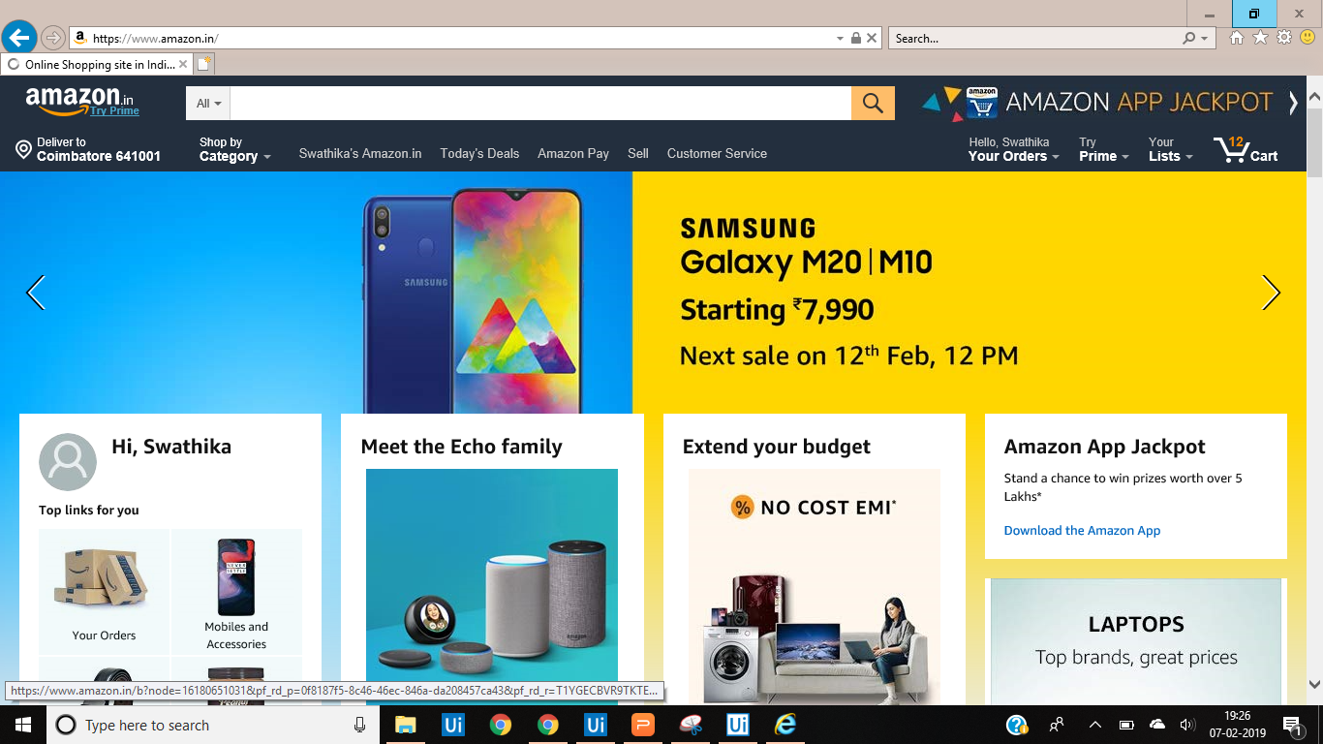
Screenshots of modules under progress

Slide 24
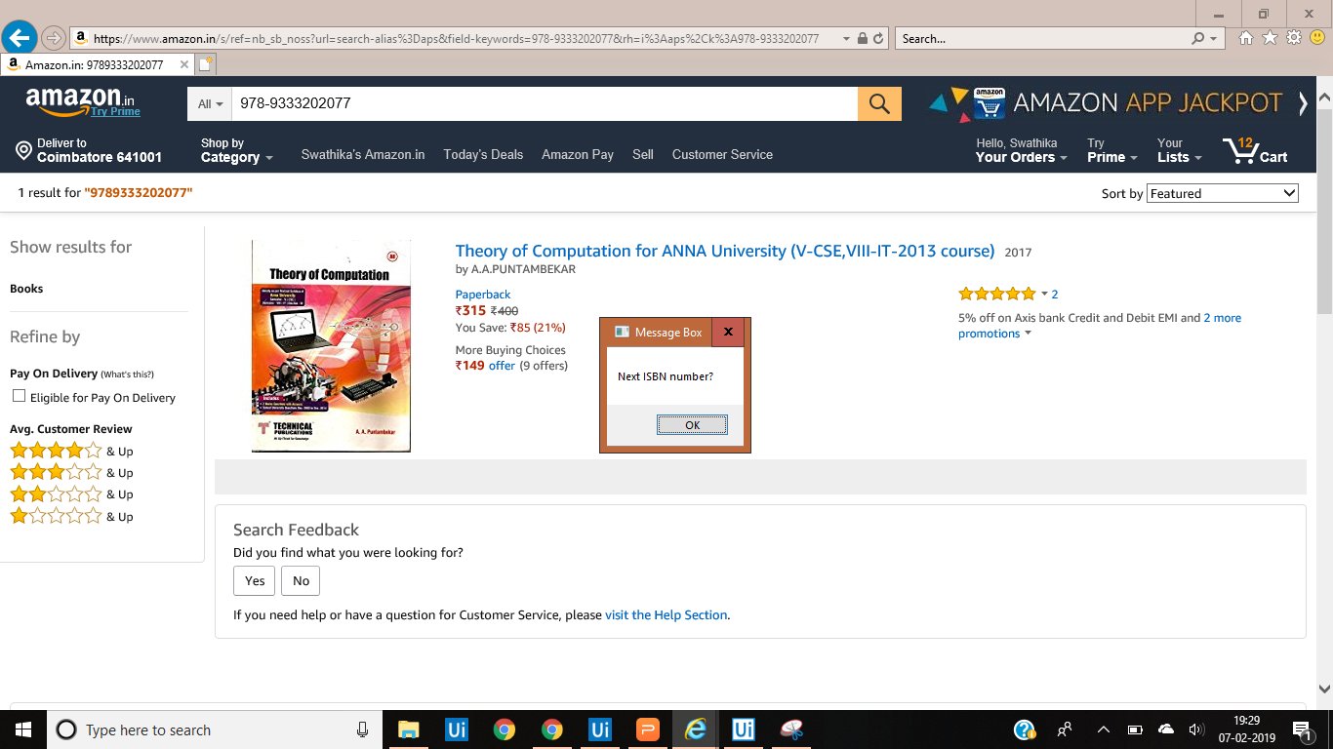
Screenshots of modules under progress

Slide 25
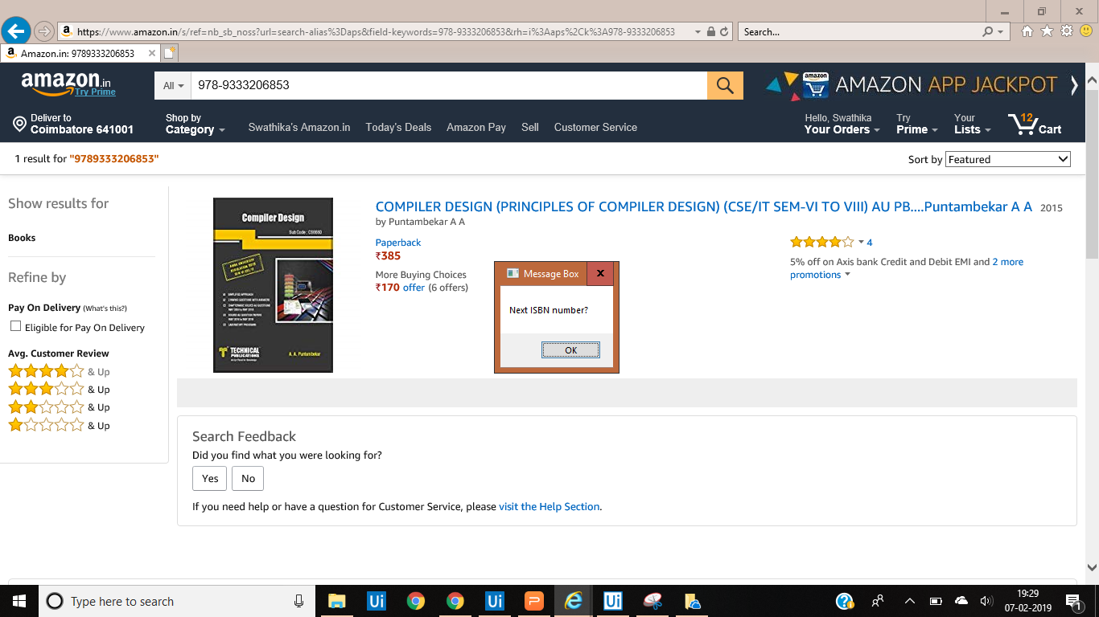
Screenshots of modules under progress

Slide 26
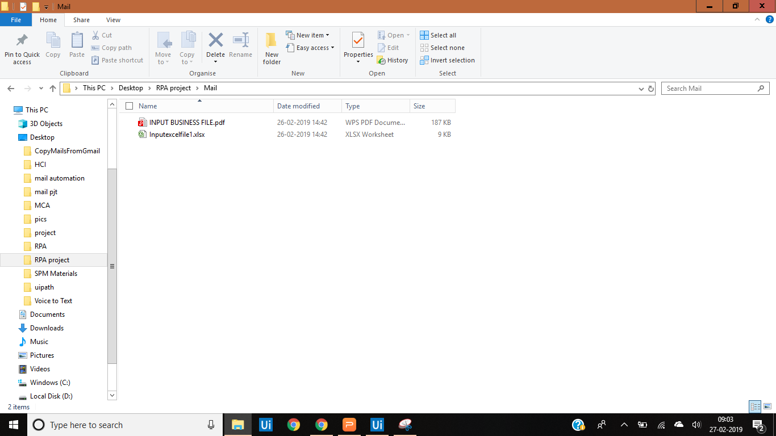
Screenshots of modules under progress

Slide 27
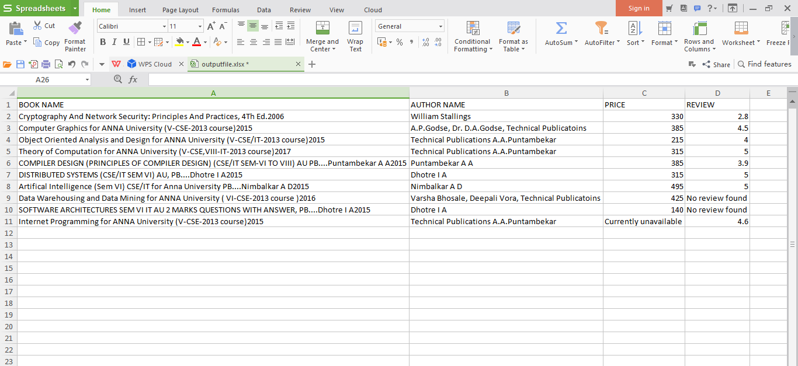
Output Snapshot

Slide 28
Thank You
Department of CSE, KGiSL Institute of Technology, Coimbatore

